Slide 1
Multi-Class Prediction of Obesity Risk
: Random Forest , LGBM , XGB , Catboost
Carolyne Jung Ju-young Jeong Jin-hyeok Choi Dae-hee Han
Period of Preparation : Only 1 week ( 23-02-2024 ~ 29-02-2024 )
Date of Presentation : 06-03-2024

Slide 2
Contents
Contest
Data
Model
Solution

Slide 3
Contents
Contest
Data
Model
Solution

Slide 4
Contents
Contest
Data
Model
Solution

Slide 5
Contents
Contest
Data
Model
Solution

Slide 6
Contents
Contest
Data
Model
Solution

Slide 7
ZERO
PROJECT INTRODUCTION

Slide 8

Contest
Libraries
Team Members
Case
Final Model
How can we create a MODEL
that predicts obesity MOST ACCURATELY ?

Slide 9
Contest
Libraries
Team Members
Case
Final Model
CORRELATION between
16 Independent variables & Dependent variable

Slide 10
Contest
Libraries
Team Members
Case
Final Model
Optimal PARAMETERS
Various MODELS

Slide 11

Contest
Libraries
Team Members
Case
Final Model
Our goal is to MAXIMIZE ACCURACY !

Slide 12
Contest
Libraries
Team Members
Case
Final Model
Scipy
os
tensorflow
random
warnings
numpy
pandas
optuna
seaborn
Sklearn
XGB
Classifier
CatBoost
Classifier
LGBM
Classifier
PrettyTable
matplotlib

Slide 13
Contest
Libraries
Team Members
Case
Final Model
GROUP FIVE
Random
Forest
EDA
Optuna
XGB
CatBoost
LGBM
Ensemble
Presenter

Slide 14
Contest
Libraries
Team Members
Case
Final Model
CAROLYNE JUNG
Random
Forest
EDA
Optuna
XGB
CatBoost
LGBM
Ensemble
Presenter

Slide 15
Contest
Libraries
Team Members
Case
Final Model
DAE - HEE HAN
Random
Forest
EDA
Optuna
XGB
CatBoost
LGBM
Ensemble
Presenter

Slide 16
Contest
Libraries
Team Members
Case
Final Model
JU - YEONG JUNG
Random
Forest
EDA
Optuna
XGB
CatBoost
LGBM
Ensemble
Presenter

Slide 17
Contest
Libraries
Team Members
Case
Final Model
JIN - HYEOK CHOI
Random
Forest
EDA
Optuna
XGB
CatBoost
LGBM
Ensemble
Presenter

Slide 18
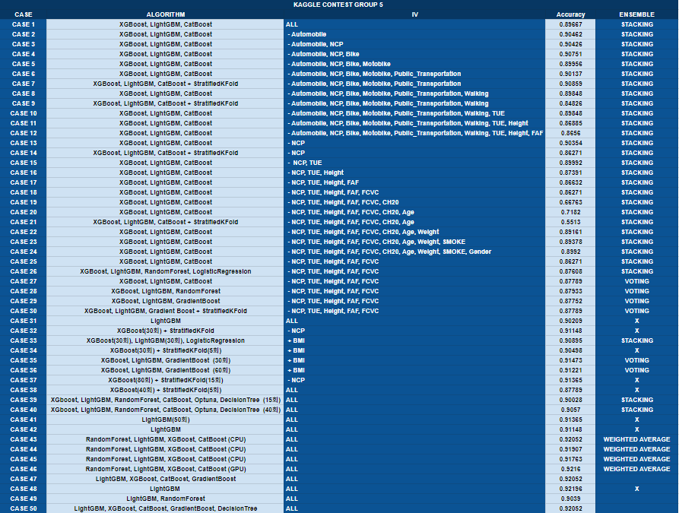

Contest
Libraries
Team Members
Case
Final Model
50
CASES

Slide 19
Contest
Libraries
Team Members
Case
Final Model
Staking
StratifiedKFold
XGBoost
StratifiedKFold
Voting
BMI
WEIGHTED
AVERAGE
Staking
50
CASES
0.9075
0.9085
0.91365
0.9147
0.9216

Slide 20
Contest
Libraries
Team Members
Case
Final Model
Staking
StratifiedKFold
XGBoost
StratifiedKFold
Voting
BMI
WEIGHTED
AVERAGE
Staking
50
CASES
0.9075
0.9085
0.91365
0.9147
0.9216

Slide 21
Contest
Libraries
Team Members
Case
Final Model
Null
Uniquqe
Data Type
Minimum
Maximum
Staking
StratifiedKFold
XGBoost
StratifiedKFold
Voting
BMI
WEIGHTED
AVERAGE
Staking
50
CASES
0.9075
0.9085
0.91365
0.9147
0.9216

Slide 22
FIRST
DATA ANALYZING

Slide 23
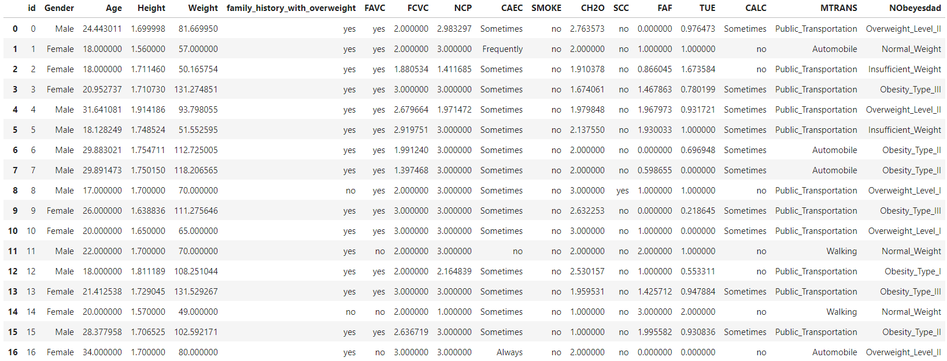
EDA
Numerical Data
Categorical Data
PCA / Kmeans
Feature Engineering
& Processing

Slide 24
EDA
Numerical Data
Categorical Data
PCA / Kmeans
Feature Engineering
& Processing
Rows 20758
Rows 20758
Columns 18
Train Data

Slide 25
EDA
Numerical Data
Categorical Data
PCA / Kmeans
Feature Engineering
& Processing
Rows 20758
Rows 20758
Columns 18
Rows 13840
Columns 17
Train Data
Test Data
( Nobeyesdad X )

Slide 26
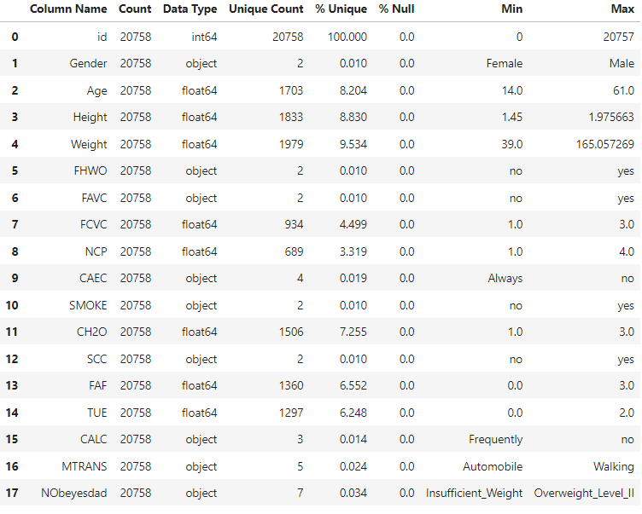
EDA
Numerical Data
Categorical Data
PCA / Kmeans
Feature Engineering
& Processing
Null (%)

Slide 27
EDA
Numerical Data
Categorical Data
PCA / Kmeans
Feature Engineering
& Processing
Null (%)
Unique (%)

Slide 28
EDA
Numerical Data
Categorical Data
PCA / Kmeans
Feature Engineering
& Processing
Null (%)
Unique (%)
Data Type

Slide 29
EDA
Numerical Data
Categorical Data
PCA / Kmeans
Feature Engineering
& Processing
Null (%)
Unique (%)
Data Type
Minimum

Slide 30
EDA
Numerical Data
Categorical Data
PCA / Kmeans
Feature Engineering
& Processing
Null (%)
Unique (%)
Data Type
Minimum
Maximum

Slide 31
EDA
Numerical Data
Categorical Data
PCA / Kmeans
Feature Engineering
& Processing
Null (%)
Unique (%)
Data Type
Minimum
Maximum

Slide 32
EDA
Numerical Data
Categorical Data
PCA / Kmeans
Feature Engineering
& Processing
Parameters
n_splits = 9
RANDOM_SEED = 73

Slide 33
EDA
Numerical Data
Categorical Data
PCA / Kmeans
Feature Engineering
& Processing
Parameters
n_splits = 9
RANDOM_SEED = 73

Slide 34
EDA
Numerical Data
Categorical Data
PCA / Kmeans
Feature Engineering
& Processing
Parameters
n_splits = 9
RANDOM_SEED = 73

Slide 35
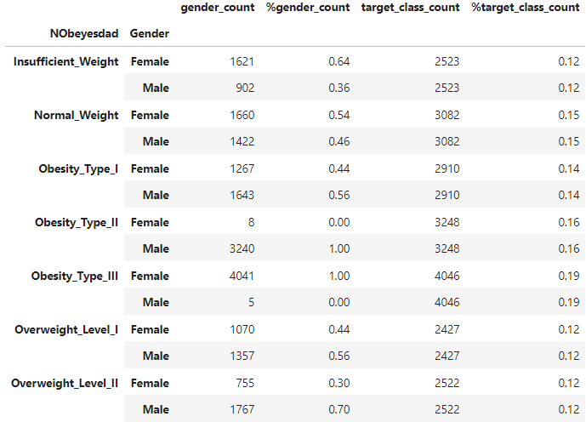
EDA
Numerical Data
Categorical Data
PCA / Kmeans
Feature Engineering
& Processing
Obesity Type II is 100% male.

Slide 36
EDA
Numerical Data
Categorical Data
PCA / Kmeans
Feature Engineering
& Processing
Obesity Type III is 100% female.

Slide 37
EDA
Numerical Data
Categorical Data
PCA / Kmeans
Feature Engineering
& Processing
Overweight Level II is 70% male.

Slide 38
EDA
Numerical Data
Categorical Data
PCA / Kmeans
Feature Engineering
& Processing
Insufficient Weight is 60% female.

Slide 39
EDA
Numerical Data
Categorical Data
PCA / Kmeans
Feature Engineering
& Processing
Insufficient Weight is 60% female.
"Gender strongly influences obesity prediction."

Slide 40
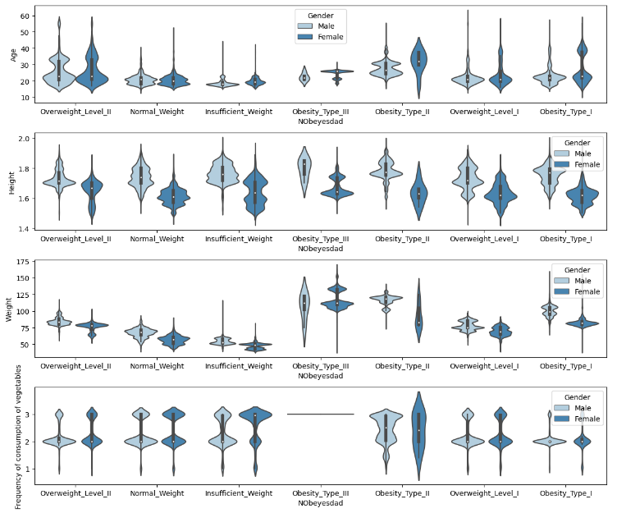
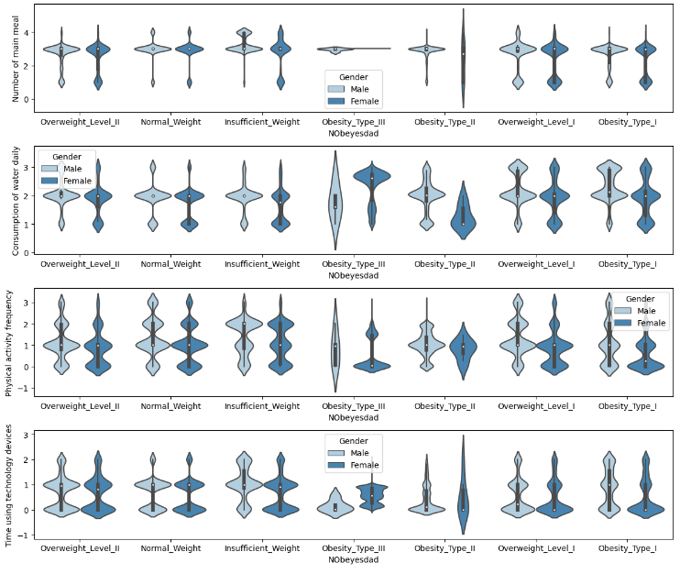
EDA
Numerical Data
Categorical Data
PCA / Kmeans
Feature Engineering
& Processing
Individual Numerical Plots - Violin Plots

Slide 41
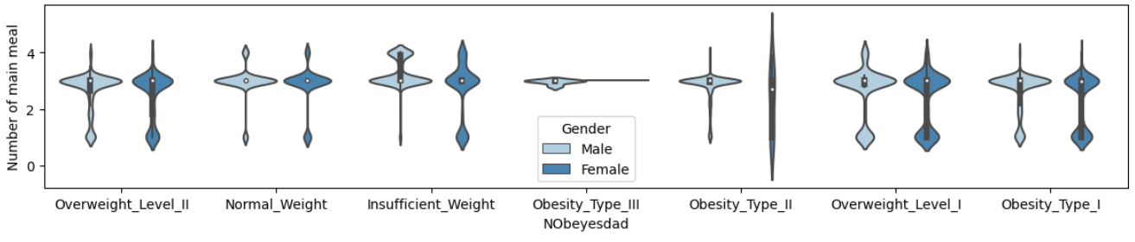
EDA
Numerical Data
Categorical Data
PCA / Kmeans
Feature Engineering
& Processing
Number of main meal - Nobeyesdad
Underweight people eat more meals to gain weight.

Slide 42
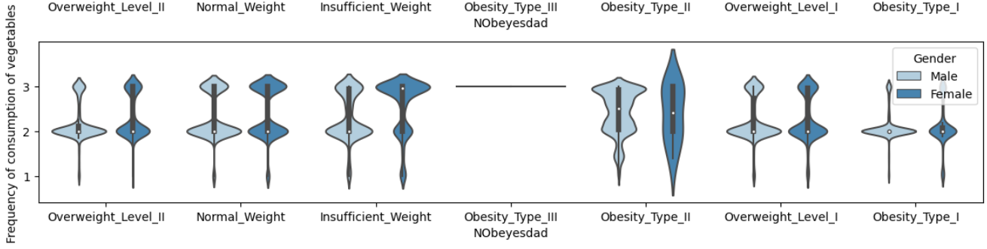
EDA
Numerical Data
Categorical Data
PCA / Kmeans
Feature Engineering
& Processing
Frequency of consumption of vegetables - Nobeyesdad
All Obesity Type III individuals eat vegetables three times.

Slide 43
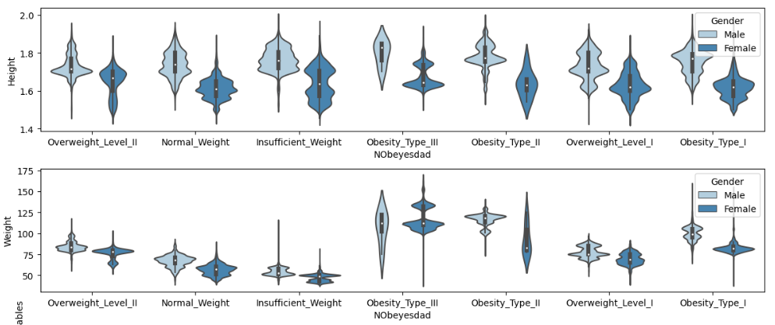
EDA
Numerical Data
Categorical Data
PCA / Kmeans
Feature Engineering
& Processing
Height , Weight and Gender are KEY factors !

Slide 44
EDA
Numerical Data
Categorical Data
PCA / Kmeans
Feature Engineering
& Processing
Height , Weight and Gender are KEY factors !

Slide 45
EDA
Numerical Data
Categorical Data
PCA / Kmeans
Feature Engineering
& Processing
Height , Weight and Gender are KEY factors !

Slide 46
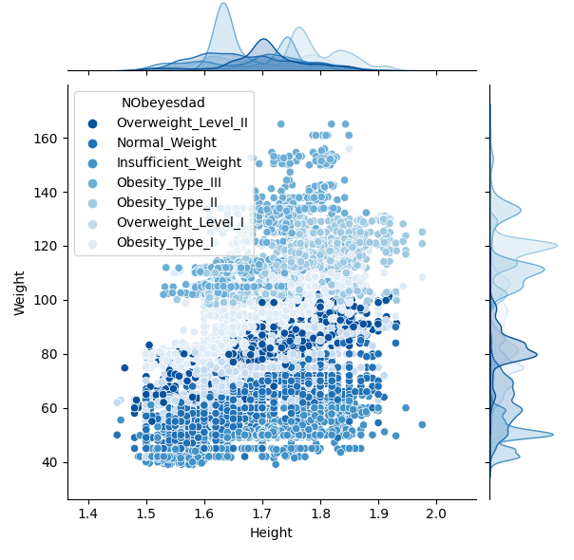
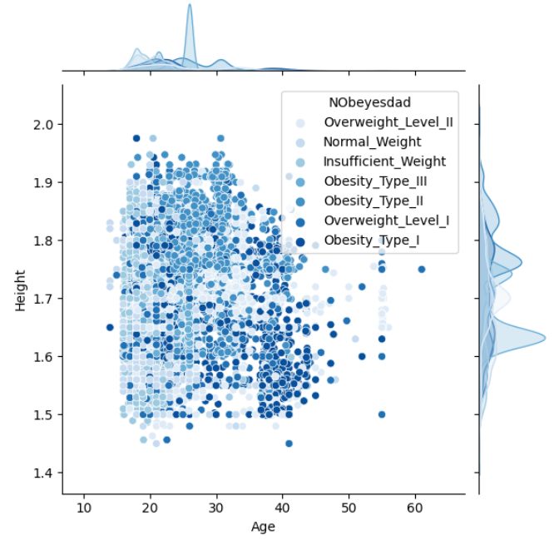
EDA
Numerical Data
Categorical Data
PCA / Kmeans
Feature Engineering
& Processing
Combined Numerical Plots - Joint Plot

Slide 47
EDA
Numerical Data
Categorical Data
PCA / Kmeans
Feature Engineering
& Processing
Combined Numerical Plots - Joint Plot
NObeyesdad
Weight
Height

Slide 48
EDA
Numerical Data
Categorical Data
PCA / Kmeans
Feature Engineering
& Processing
Combined Numerical Plots - Joint Plot
NObeyesdad
Age
Height

Slide 49
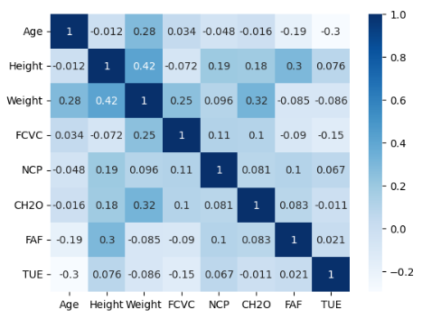
EDA
Numerical Data
Categorical Data
PCA / Kmeans
Feature Engineering
& Processing
Numerical Correlation Plot - Heatmap / Pearson

Slide 50
EDA
Numerical Data
Categorical Data
PCA / Kmeans
Feature Engineering
& Processing
Numerical Correlation Plot - Heatmap / Pearson
Height : Weight & FAF have a positive correlation.

Slide 51
EDA
Numerical Data
Categorical Data
PCA / Kmeans
Feature Engineering
& Processing
Numerical Correlation Plot - Heatmap / Pearson
Weight : Heavier people drink more water.

Slide 52
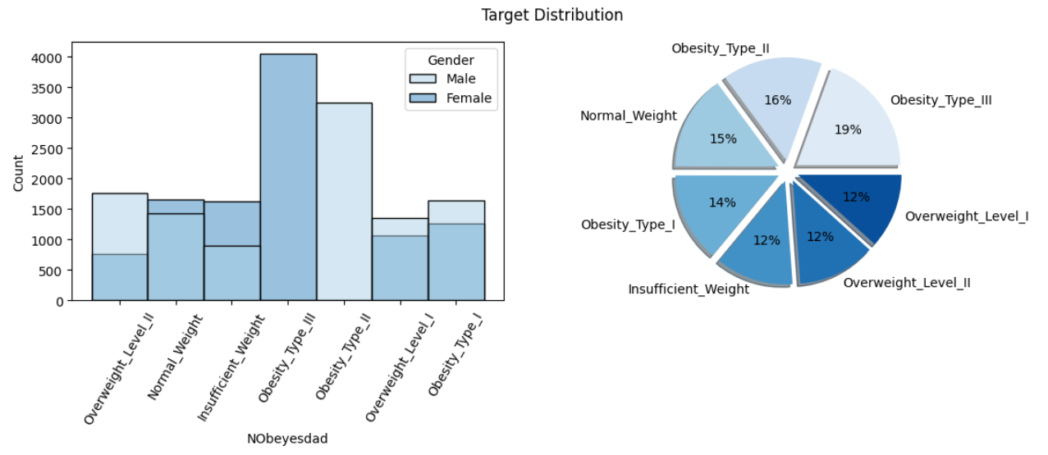
EDA
Numerical Data
Categorical Data
PCA / Kmeans
Feature Engineering
& Processing
Target Distribution with Gender - Histogram, Pie chart

Slide 53
EDA
Numerical Data
Categorical Data
PCA / Kmeans
Feature Engineering
& Processing
Target Distribution with Gender - Histogram, Pie chart

Slide 54
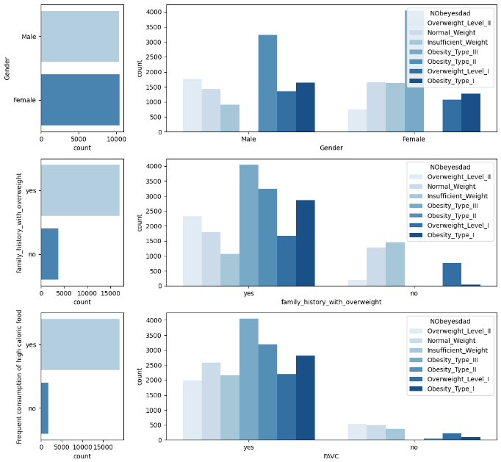
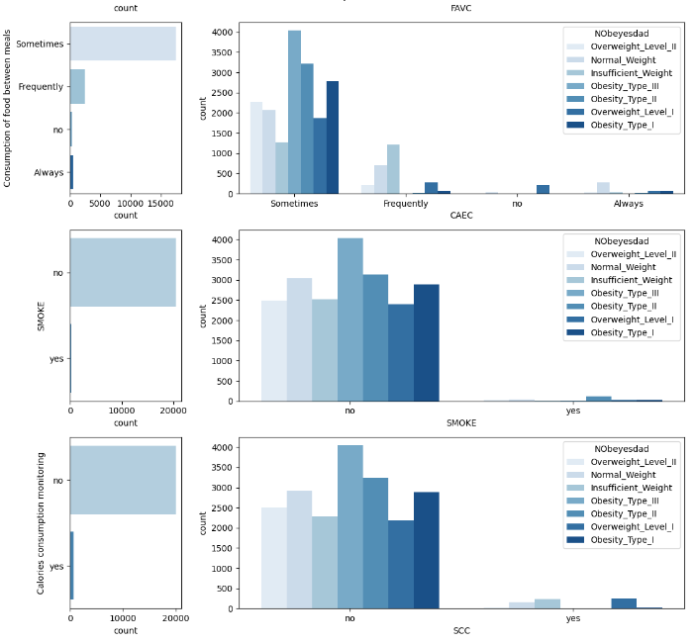
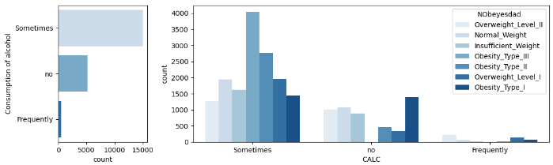
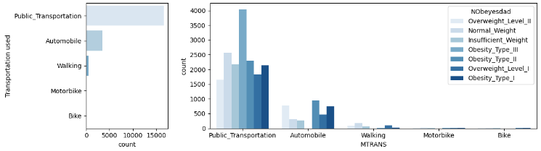
EDA
Numerical Data
Categorical Data
PCA / Kmeans
Feature Engineering
& Processing
Individual Categorical Plots - Count Plot

Slide 55
EDA
Numerical Data
Categorical Data
PCA / Kmeans
Feature Engineering
& Processing
Individual Categorical Plots - Count Plot

Slide 56
EDA
Numerical Data
Categorical Data
PCA / Kmeans
Feature Engineering
& Processing
Individual Categorical Plots - Count Plot

Slide 57
EDA
Numerical Data
Categorical Data
PCA / Kmeans
Feature Engineering
& Processing
Individual Categorical Plots - Count Plot

Slide 58
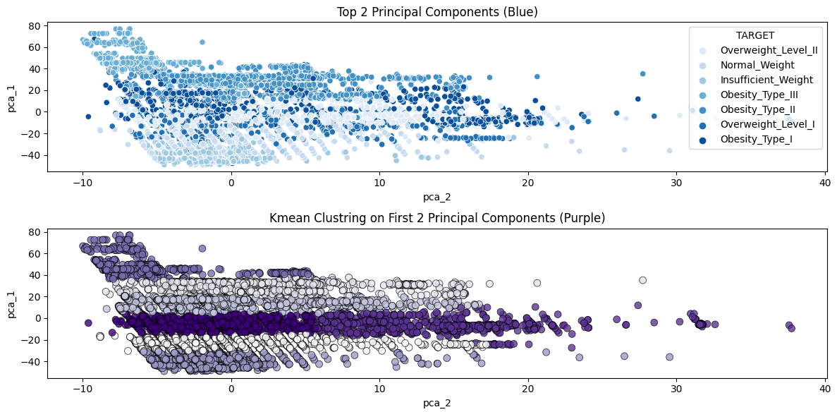
EDA
Numerical Data
Categorical Data
PCA / Kmeans
Feature Engineering
& Processing
Principal Component Analysis (PCA) & KMeans

Slide 59
EDA
Numerical Data
Categorical Data
PCA / Kmeans
Feature Engineering
& Processing
Principal Component Analysis (PCA) & KMeans

Slide 60
EDA
Numerical Data
Categorical Data
PCA / Kmeans
Feature Engineering
& Processing
Principal Component Analysis (PCA) & KMeans

Slide 61
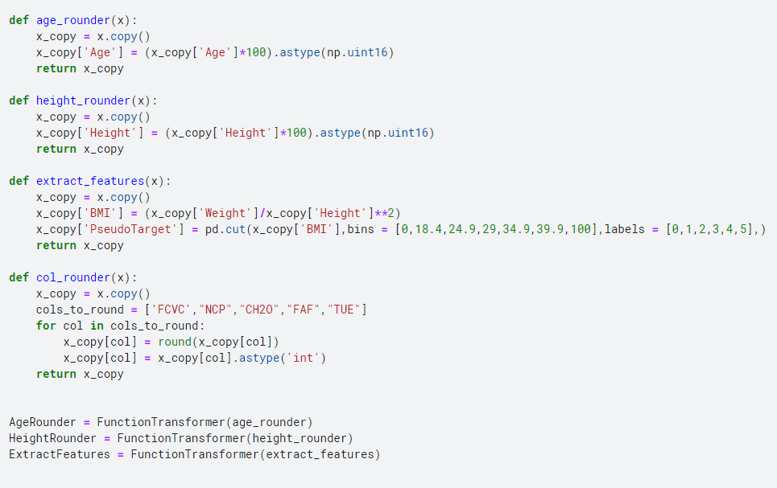
EDA
Numerical Data
Categorical Data
PCA / Kmeans
Feature Engineering
& Processing
Define & improve data preprocessing functions
Convert to integer type for ease of modeling.

Slide 62
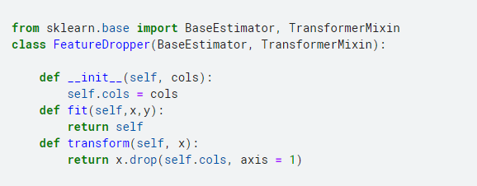
EDA
Numerical Data
Categorical Data
PCA / Kmeans
Feature Engineering
& Processing
Define & improve data preprocessing functions
With FeatureDropper ,
we removed unnecessary columns from the data.

Slide 63
EDA
Numerical Data
Categorical Data
PCA / Kmeans
Feature Engineering
& Processing
Define Cross_val_model
Stratified K-Fold
Deduplication
3 DataFrames

Slide 64
EDA
Numerical Data
Categorical Data
PCA / Kmeans
Feature Engineering
& Processing
Define Cross_val_model
Stratified K-Fold
Deduplication
3 DataFrames

Slide 65
EDA
Numerical Data
Categorical Data
PCA / Kmeans
Feature Engineering
& Processing
Define Cross_val_model
Stratified K-Fold
Deduplication
3 DataFrames

Slide 66
EDA
Numerical Data
Categorical Data
PCA / Kmeans
Feature Engineering
& Processing
Define Cross_val_model
Stratified K-Fold
Deduplication
3 DataFrames

Slide 67
SECOND
MODELS

Slide 68
Random Forest Model
LGBM Model
XGB Model
CatBoost Model
Model Evaluaton
We use MULTIPLE high-performing models instead of just one.

Slide 69
Random Forest Model
LGBM Model
XGB Model
CatBoost Model
Model Evaluaton
We used FOUR Models in the competition.

Slide 70
Random Forest Model
LGBM Model
XGB Model
CatBoost Model
Model Evaluaton
Random Forest

Slide 71
Random Forest Model
LGBM Model
XGB Model
CatBoost Model
Model Evaluaton
Random Forest
LGBM Model

Slide 72
Random Forest Model
LGBM Model
XGB Model
CatBoost Model
Model Evaluaton
Random Forest
LGBM Model
XGB Model

Slide 73
Random Forest Model
LGBM Model
XGB Model
CatBoost Model
Model Evaluaton
Random Forest
LGBM Model
XGB Model
CatBoost

Slide 74
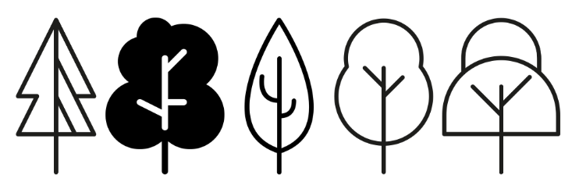
Random Forest Model
LGBM Model
XGB Model
CatBoost Model
Model Evaluaton
Random Forest Model

Slide 75
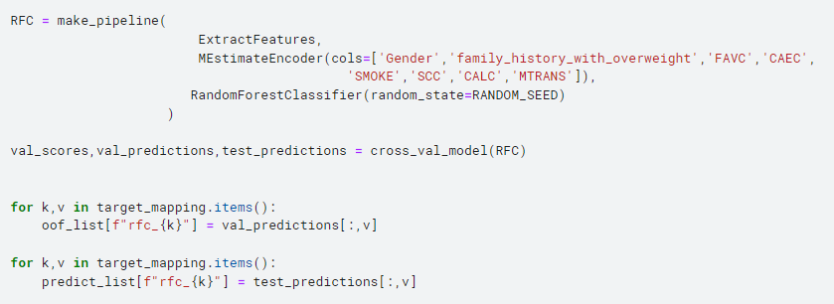
Random Forest Model
LGBM Model
XGB Model
CatBoost Model
Model Evaluaton
Random Forest Model
Extracting NEW features

Slide 76
Random Forest Model
LGBM Model
XGB Model
CatBoost Model
Model Evaluaton
Random Forest Model
Extracting NEW features & Encoding

Slide 77
Random Forest Model
LGBM Model
XGB Model
CatBoost Model
Model Evaluaton
Random Forest Model
Using make_pipeline to link data preprocessing & modeling

Slide 78
Random Forest Model
LGBM Model
XGB Model
CatBoost Model
Model Evaluaton
Random Forest Model
Perform cross-validation to evaluate the model

Slide 79
Random Forest Model
LGBM Model
XGB Model
CatBoost Model
Model Evaluaton
Random Forest Model
Validation predictions for each target class

Slide 80
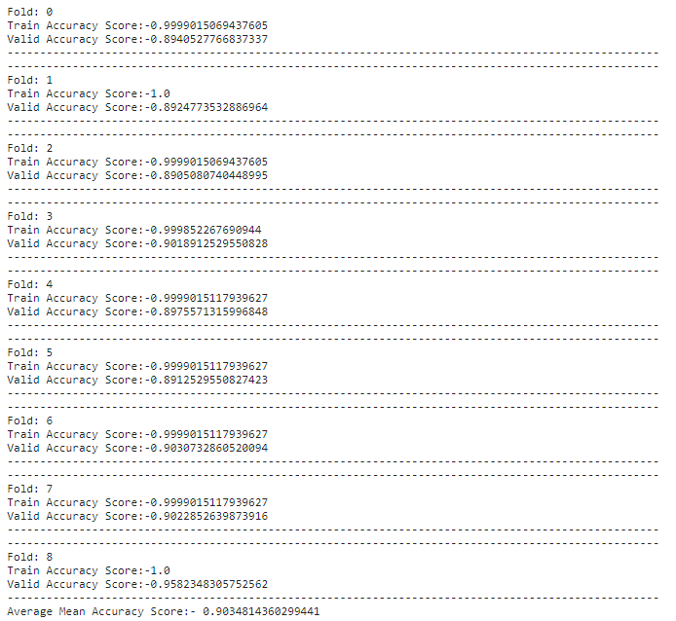
Random Forest Model
LGBM Model
XGB Model
CatBoost Model
Model Evaluaton
Random Forest Model
Final accuracy of the Random Forest model
: 0.90348

Slide 81

Random Forest Model
LGBM Model
XGB Model
CatBoost Model
Model Evaluaton
LGBM (LightGBM) Model
SUPER FAST & EXACT

Slide 82
Random Forest Model
LGBM Model
XGB Model
CatBoost Model
Model Evaluaton
LGBM (LightGBM) Model
SUPER FAST & EXACT

Slide 83
Random Forest Model
LGBM Model
XGB Model
CatBoost Model
Model Evaluaton
LGBM (LightGBM) Model
SUPER FAST & EXACT

Slide 84
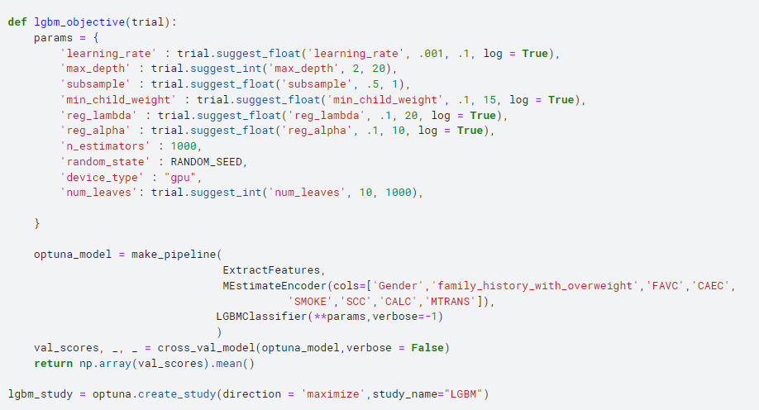
Random Forest Model
LGBM Model
XGB Model
CatBoost Model
Model Evaluaton
LGBM (LightGBM) Model
Define the range of parameters to be tuned

Slide 85
Random Forest Model
LGBM Model
XGB Model
CatBoost Model
Model Evaluaton
LGBM (LightGBM) Model
Define Optuna Function To Tune LGBM Model

Slide 86
Random Forest Model
LGBM Model
XGB Model
CatBoost Model
Model Evaluaton
LGBM (LightGBM) Model
Create a pipeline to compose the model

Slide 87
Random Forest Model
LGBM Model
XGB Model
CatBoost Model
Model Evaluaton
LGBM (LightGBM) Model
After cross-validation, Create an Optuna study

Slide 88
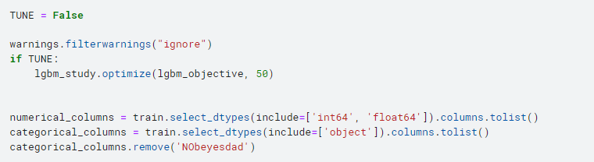
Random Forest Model
LGBM Model
XGB Model
CatBoost Model
Model Evaluaton
LGBM (LightGBM) Model
TUNE is True or False ?

Slide 89
Random Forest Model
LGBM Model
XGB Model
CatBoost Model
Model Evaluaton
LGBM (LightGBM) Model
Optuna or Default hyperparameter value

Slide 90
Random Forest Model
LGBM Model
XGB Model
CatBoost Model
Model Evaluaton
LGBM (LightGBM) Model
Use numerical & categorical features from the train data

Slide 91
Random Forest Model
LGBM Model
XGB Model
CatBoost Model
Model Evaluaton
LGBM (LightGBM) Model
Excluding 'NObeyesdad’ from the train data

Slide 92
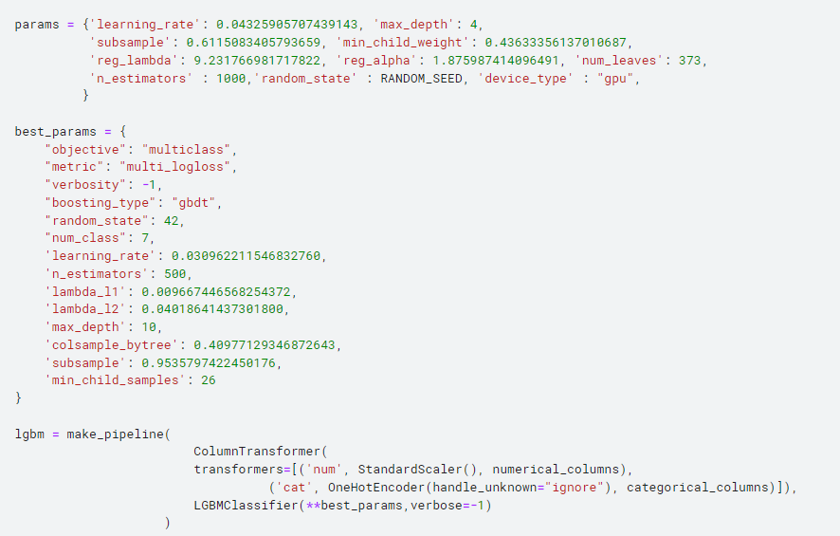
Random Forest Model
LGBM Model
XGB Model
CatBoost Model
Model Evaluaton
LGBM (LightGBM) Model
Categorical used One-Hot Encoder

Slide 93
Random Forest Model
LGBM Model
XGB Model
CatBoost Model
Model Evaluaton
LGBM (LightGBM) Model
Numeric used Standard Scaler

Slide 94
Random Forest Model
LGBM Model
XGB Model
CatBoost Model
Model Evaluaton
LGBM (LightGBM) Model
Define Hyperparameters for LightGBM models

Slide 95
Random Forest Model
LGBM Model
XGB Model
CatBoost Model
Model Evaluaton
LGBM (LightGBM) Model
Define Optimized hyperparameters for the model

Slide 96
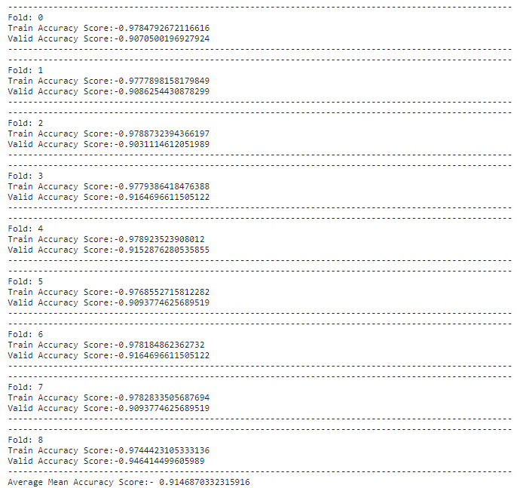
Random Forest Model
LGBM Model
XGB Model
CatBoost Model
Model Evaluaton
LGBM (LightGBM) Model
Final accuracy of the LGBM model
: 0.91468

Slide 97
Random Forest Model
LGBM Model
XGB Model
CatBoost Model
Model Evaluaton
XGBoost Model
Failure is the mother of success

Slide 98
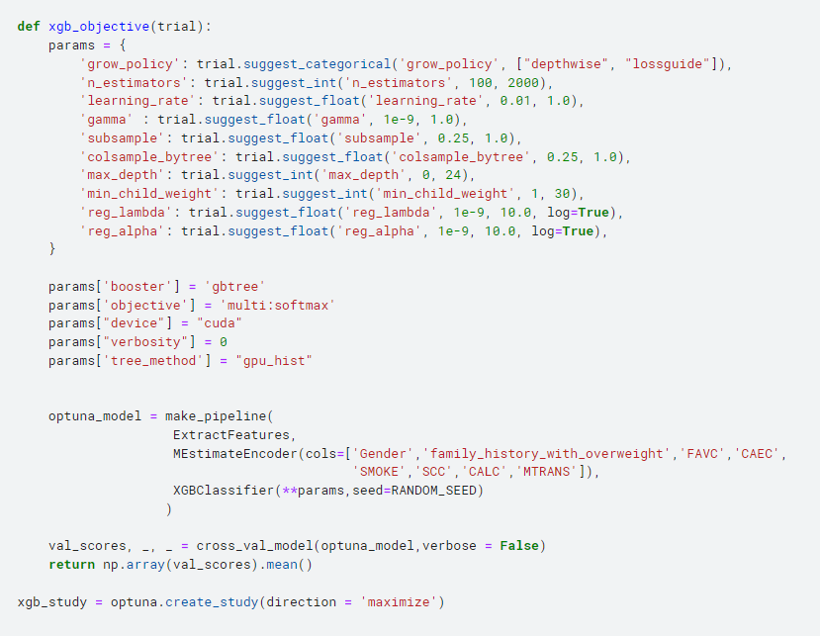
Random Forest Model
LGBM Model
XGB Model
CatBoost Model
Model Evaluaton
XGBoost Model
Define Optuna Function To Tune XGB Model

Slide 99
Random Forest Model
LGBM Model
XGB Model
CatBoost Model
Model Evaluaton
XGBoost Model
Set the parameter ranges for tuning

Slide 100
Random Forest Model
LGBM Model
XGB Model
CatBoost Model
Model Evaluaton
XGBoost Model
Configure the Model & Pipeline

Slide 101
Random Forest Model
LGBM Model
XGB Model
CatBoost Model
Model Evaluaton
XGBoost Model
After cross-validation, Create an Optuna study

Slide 102
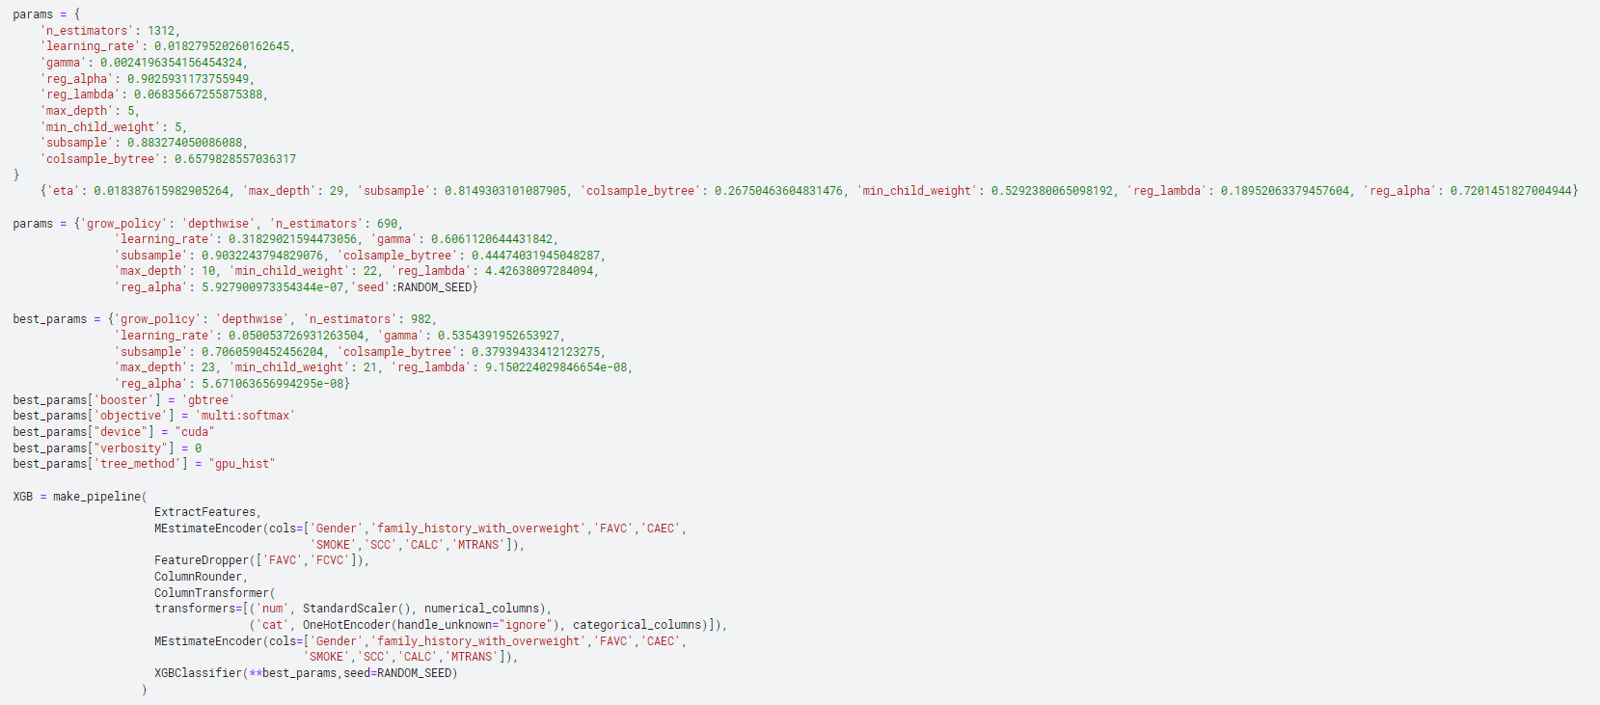
Random Forest Model
LGBM Model
XGB Model
CatBoost Model
Model Evaluaton
XGBoost Model
Setting parameters for the XGBoost model

Slide 103
Random Forest Model
LGBM Model
XGB Model
CatBoost Model
Model Evaluaton
XGBoost Model
Define Optimal parameters for the XGBoost model

Slide 104
Random Forest Model
LGBM Model
XGB Model
CatBoost Model
Model Evaluaton
XGBoost Model
Constructing the XGBoost pipeline

Slide 105
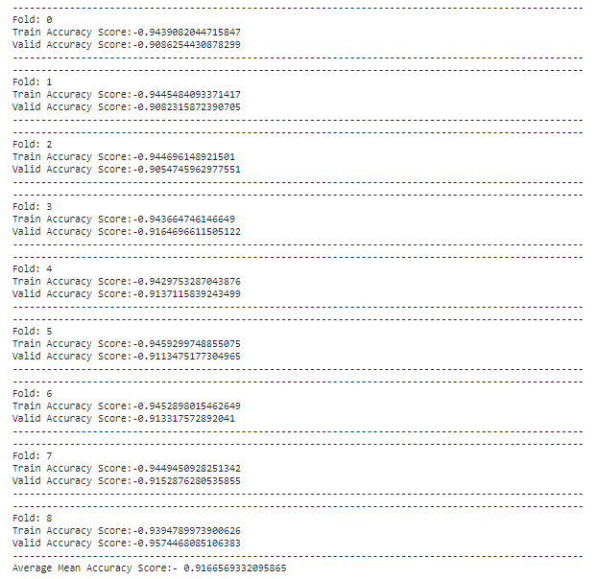
Random Forest Model
LGBM Model
XGB Model
CatBoost Model
Model Evaluaton
XGBoost Model
Final accuracy of the XGB model
: 0.91665

Slide 106

Random Forest Model
LGBM Model
XGB Model
CatBoost Model
Model Evaluaton
CatBoost Model

Slide 107
Random Forest Model
LGBM Model
XGB Model
CatBoost Model
Model Evaluaton
CatBoost Model
It can handle categorical variables on its own.

Slide 108
Random Forest Model
LGBM Model
XGB Model
CatBoost Model
Model Evaluaton
CatBoost Model
Data preprocessing is EASY.

Slide 109
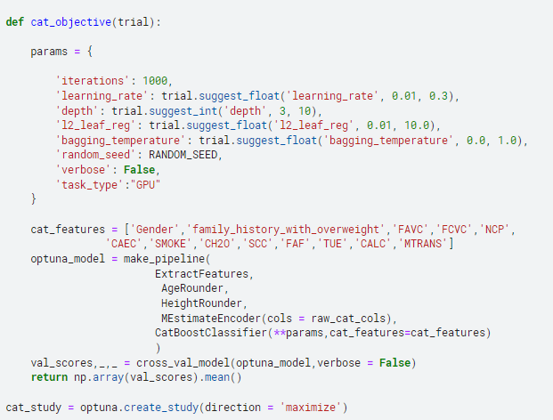
Random Forest Model
LGBM Model
XGB Model
CatBoost Model
Model Evaluaton
CatBoost Model
Define Optimal parameters for the CatBoost model

Slide 110
Random Forest Model
LGBM Model
XGB Model
CatBoost Model
Model Evaluaton
CatBoost Model
Set the hyperparameter ranges to be tuned

Slide 111
Random Forest Model
LGBM Model
XGB Model
CatBoost Model
Model Evaluaton
CatBoost Model
Define the list of categorical features

Slide 112
Random Forest Model
LGBM Model
XGB Model
CatBoost Model
Model Evaluaton
CatBoost Model
Create a Pipeline to configure the model

Slide 113
Random Forest Model
LGBM Model
XGB Model
CatBoost Model
Model Evaluaton
CatBoost Model
After cross-validation, Create an Optuna study

Slide 114
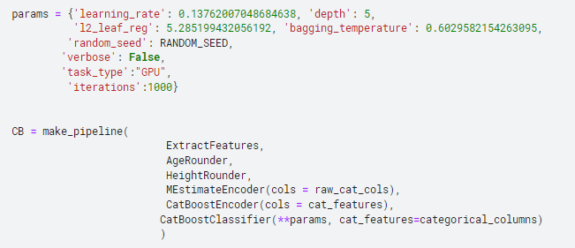
Random Forest Model
LGBM Model
XGB Model
CatBoost Model
Model Evaluaton
CatBoost Model
Define the CatBoost pipeline with tuned hyperparameters

Slide 115
Random Forest Model
LGBM Model
XGB Model
CatBoost Model
Model Evaluaton
CatBoost Model
Create a Pipeline for CatBoost model

Slide 116
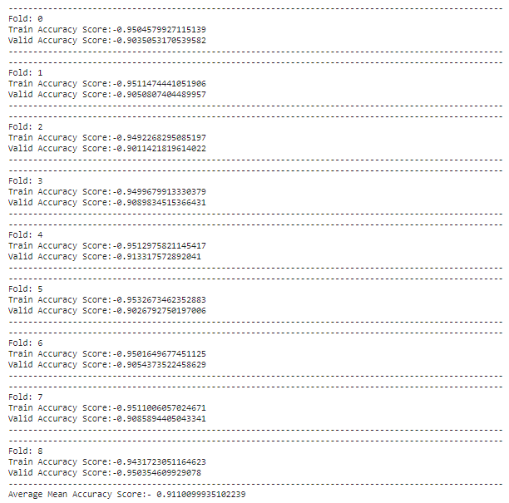
Random Forest Model
LGBM Model
XGB Model
CatBoost Model
Model Evaluaton
CatBoost Model
Final accuracy of the CatBoost model
: 0.91100

Slide 117
Random Forest Model
LGBM Model
XGB Model
CatBoost Model
Model Evaluation
Model Evaluation
Random Forest
LGBM Model
XGB Model
CatBoost

Slide 118
Random Forest Model
LGBM Model
XGB Model
CatBoost Model
Model Evaluation
Model Evaluation
0.90348
LGBM Model
XGB Model
CatBoost

Slide 119
Random Forest Model
LGBM Model
XGB Model
CatBoost Model
Model Evaluation
Model Evaluation
0.90348
0.91468
XGB Model
CatBoost

Slide 120
Random Forest Model
LGBM Model
XGB Model
CatBoost Model
Model Evaluation
Model Evaluation
0.90348
0.91468
0.91665
CatBoost

Slide 121
Random Forest Model
LGBM Model
XGB Model
CatBoost Model
Model Evaluation
Model Evaluation
0.90348
0.91468
0.91665
0.91100

Slide 122
THIRD
BUSINESS MODEL

Slide 123
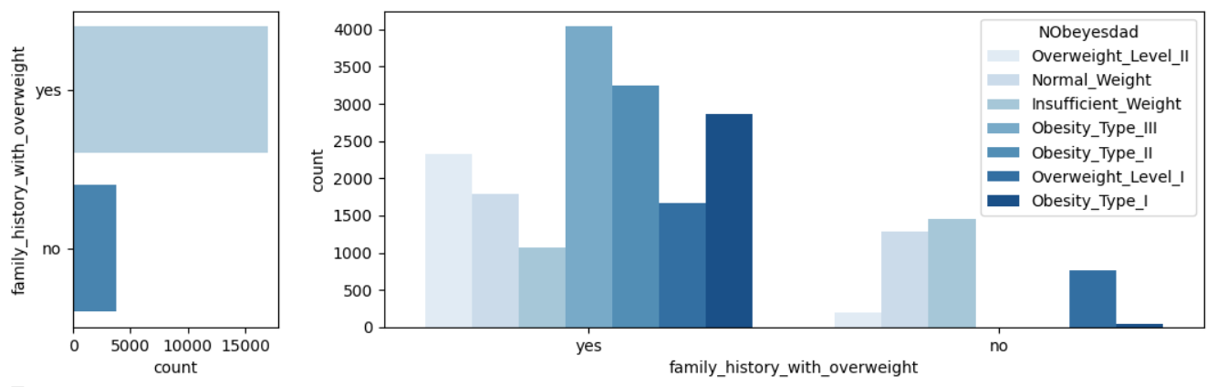
Why
Who
How
Value
Benefit
Individual Categorical Plots - Count Plot

Slide 124
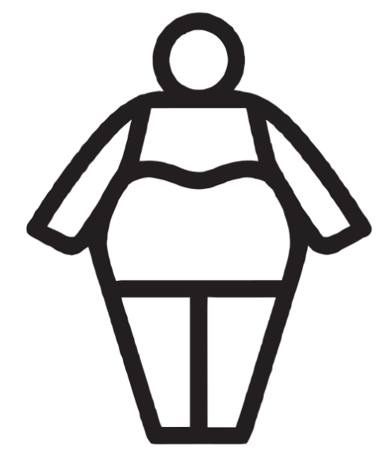
Why
Who
How
Value
Benefit
TARGET - Individual with family history of obesity

Slide 125
Why
Who
How
Value
Benefit
The Way to Avoid
a family history of obesity

Slide 126

Why
Who
How
Value
Benefit

Slide 127

Why
Who
How
Value
Benefit

Slide 128

Why
Who
How
Value
Benefit

Slide 129
Why
Who
How
Value
Benefit
The Way to Avoid
a family history of obesity

Slide 130
Why
Who
How
Value
Benefit
The Way to make
Everyone Healthy

Slide 131
Why
Who
How
Value
Benefit
The market for managing
various obesity

Slide 132
Why
Who
How
Value
Benefit
The market for managing childhood obesity

Slide 133
Summary in Korean
Carolyne Jung Ju-young Jeong Jin-hyeok Choi Dae-hee Han
Period for A to Z : Only 1 week ( 23-02-2024 ~ 29-02-2024 )
Date of Presentation : 06-03-2024

Slide 134
Summary in English
Carolyne Jung Ju-young Jeong Jin-hyeok Choi Dae-hee Han
Period for A to Z : Only 1 week ( 23-02-2024 ~ 29-02-2024 )
Date of Presentation : 06-03-2024

Slide 135
Q & A
Carolyne Jung Ju-young Jeong Jin-hyeok Choi Dae-hee Han
Period for A to Z : Only 1 week ( 23-02-2024 ~ 29-02-2024 )
Date of Presentation : 06-03-2024

Slide 136
Thank You for Listening !
Carolyne Jung Ju-young Jeong Jin-hyeok Choi Dae-hee Han
Period for A to Z : Only 1 week ( 23-02-2024 ~ 29-02-2024 )
Date of Presentation : 06-03-2024

